Slide 1
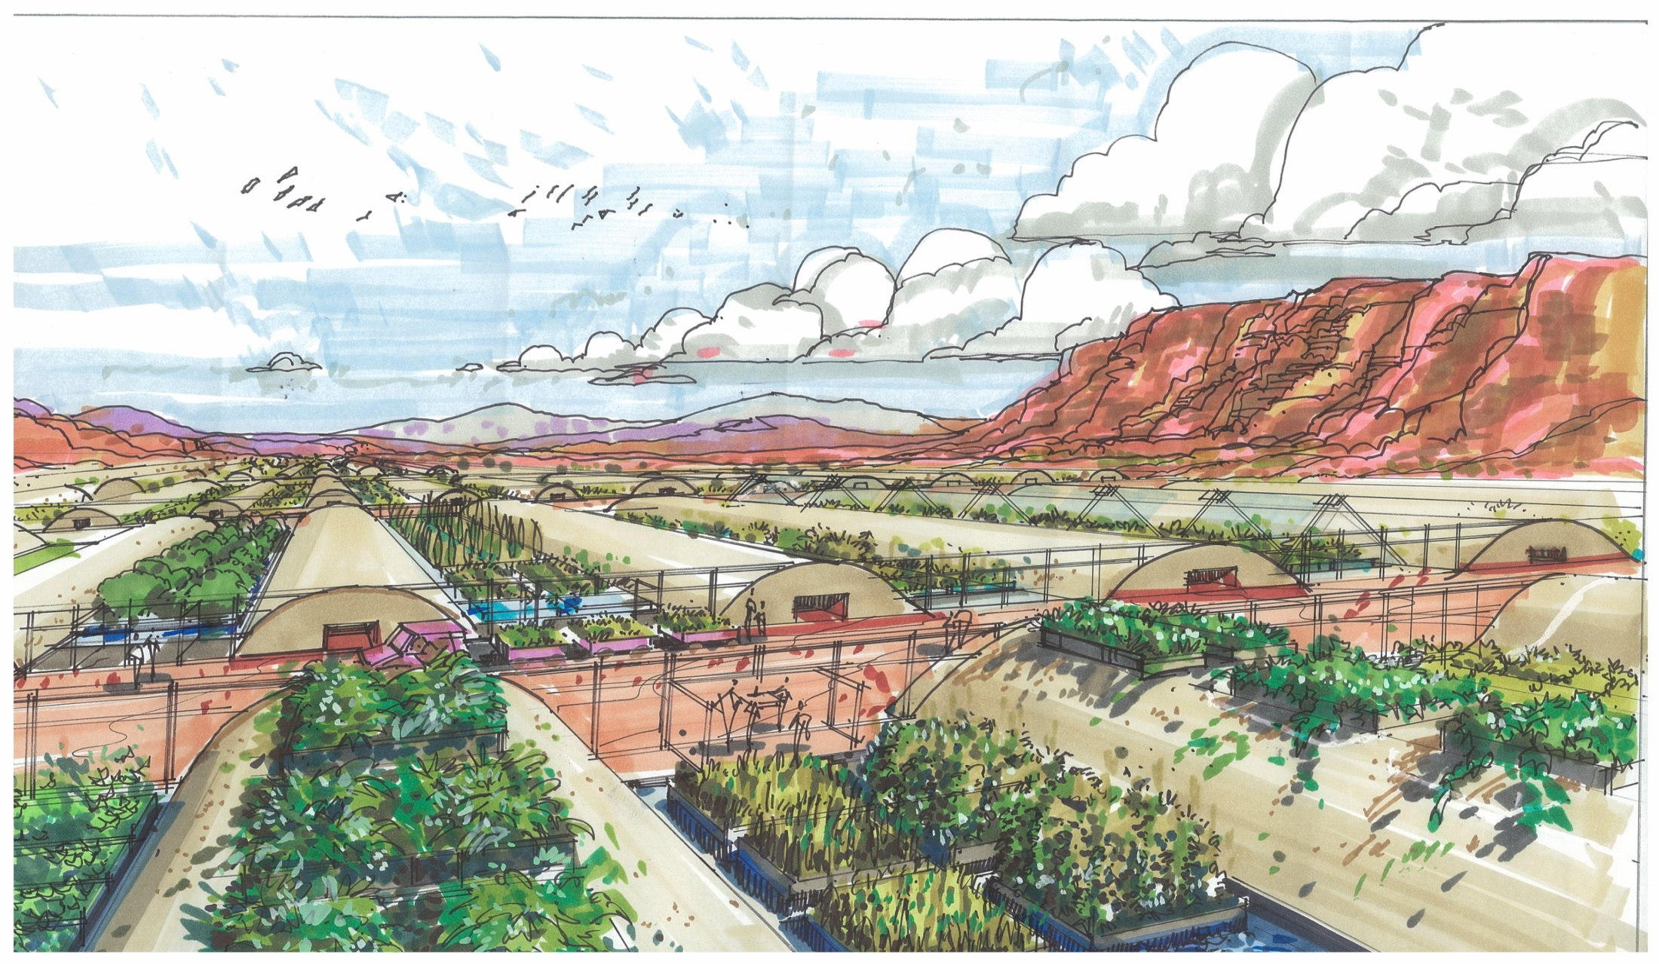
This is where true freedom begins --
Owning your own sustainable food supply and living in a balanced healthy environment debt free -- Join Terraculture Project Today
Notes:
‹#›

Slide 2
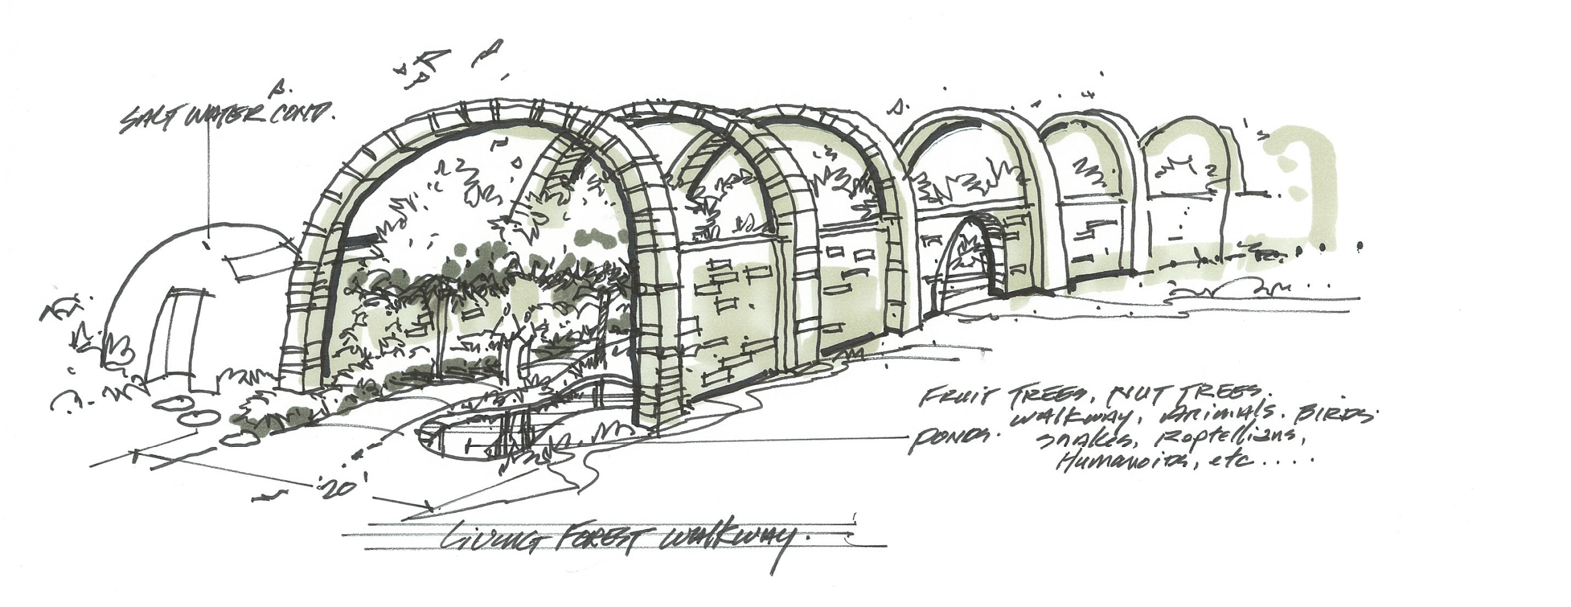
Imagine…
…a unique integrated growing solution that will revolutionize the way we think about our food and nutrition
Notes:
‹#›

Slide 3
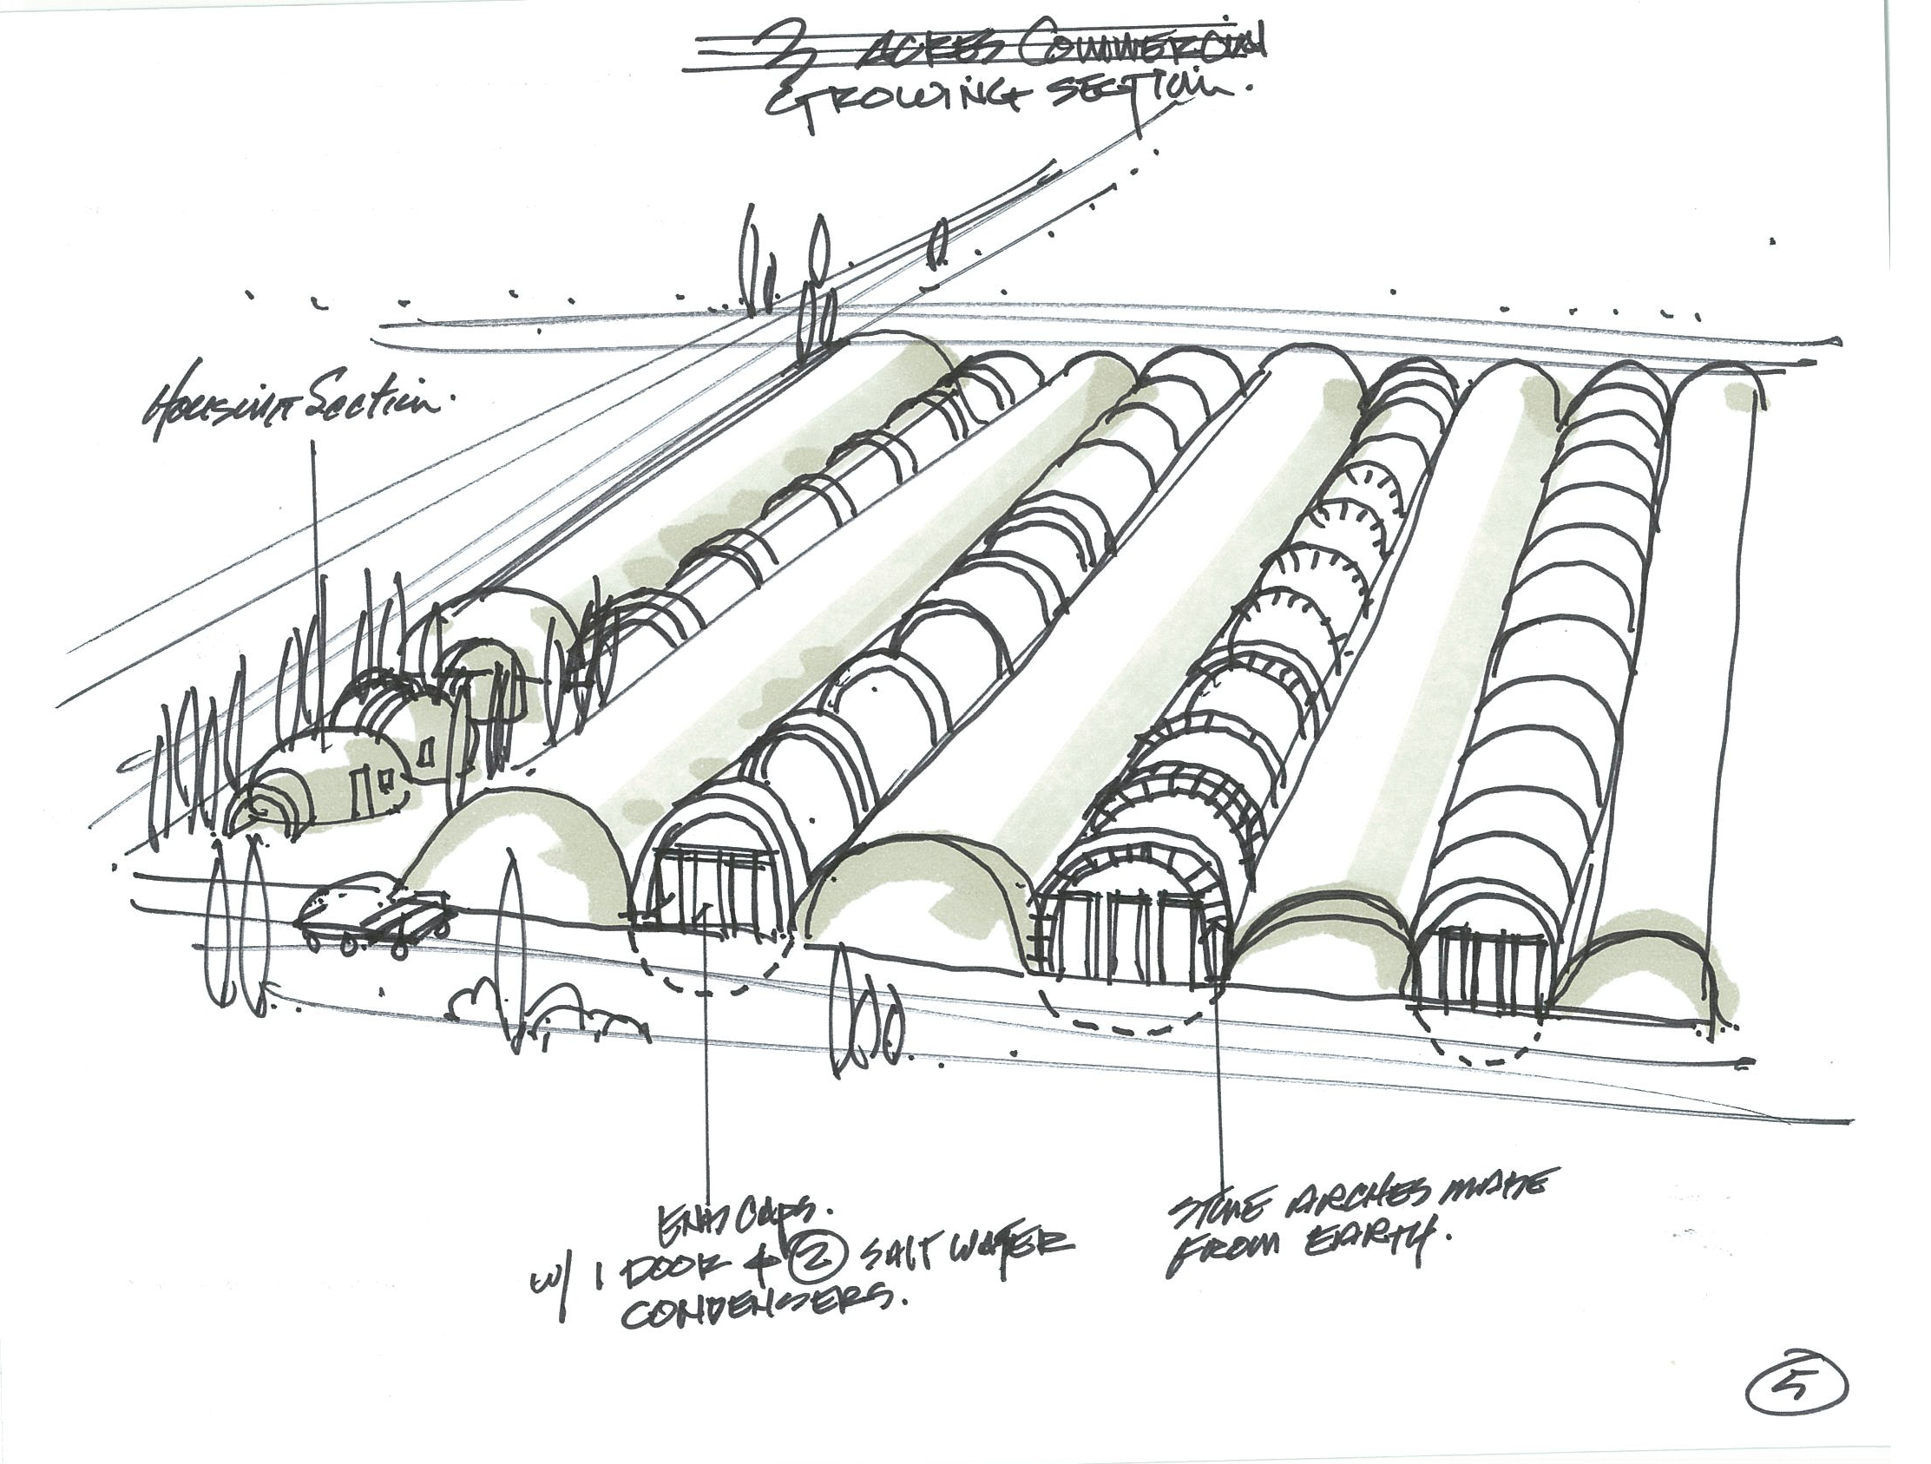
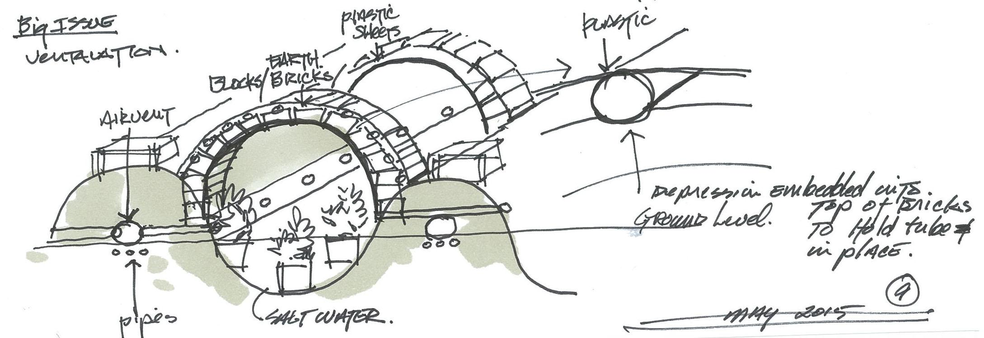
Imagine…
…terraculture greenhouses and living walls built with the resources onsite at a fraction of the typical greenhouse cost
Notes:
‹#›

Slide 4
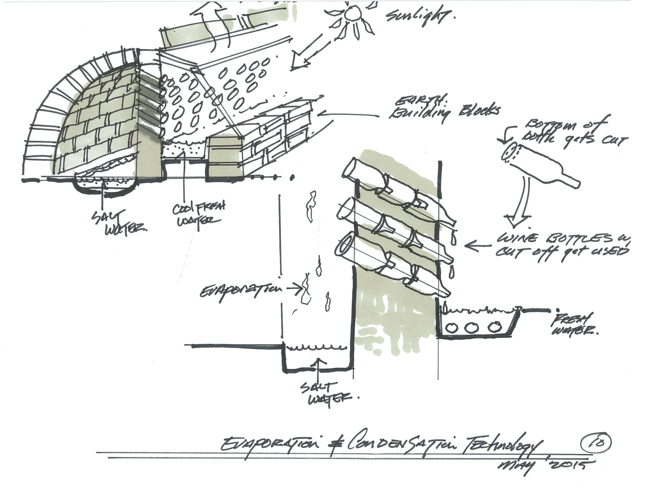
…built with dirt as strong as concrete; illuminated, heated and cooled off the grid
Notes:
‹#›

Slide 5
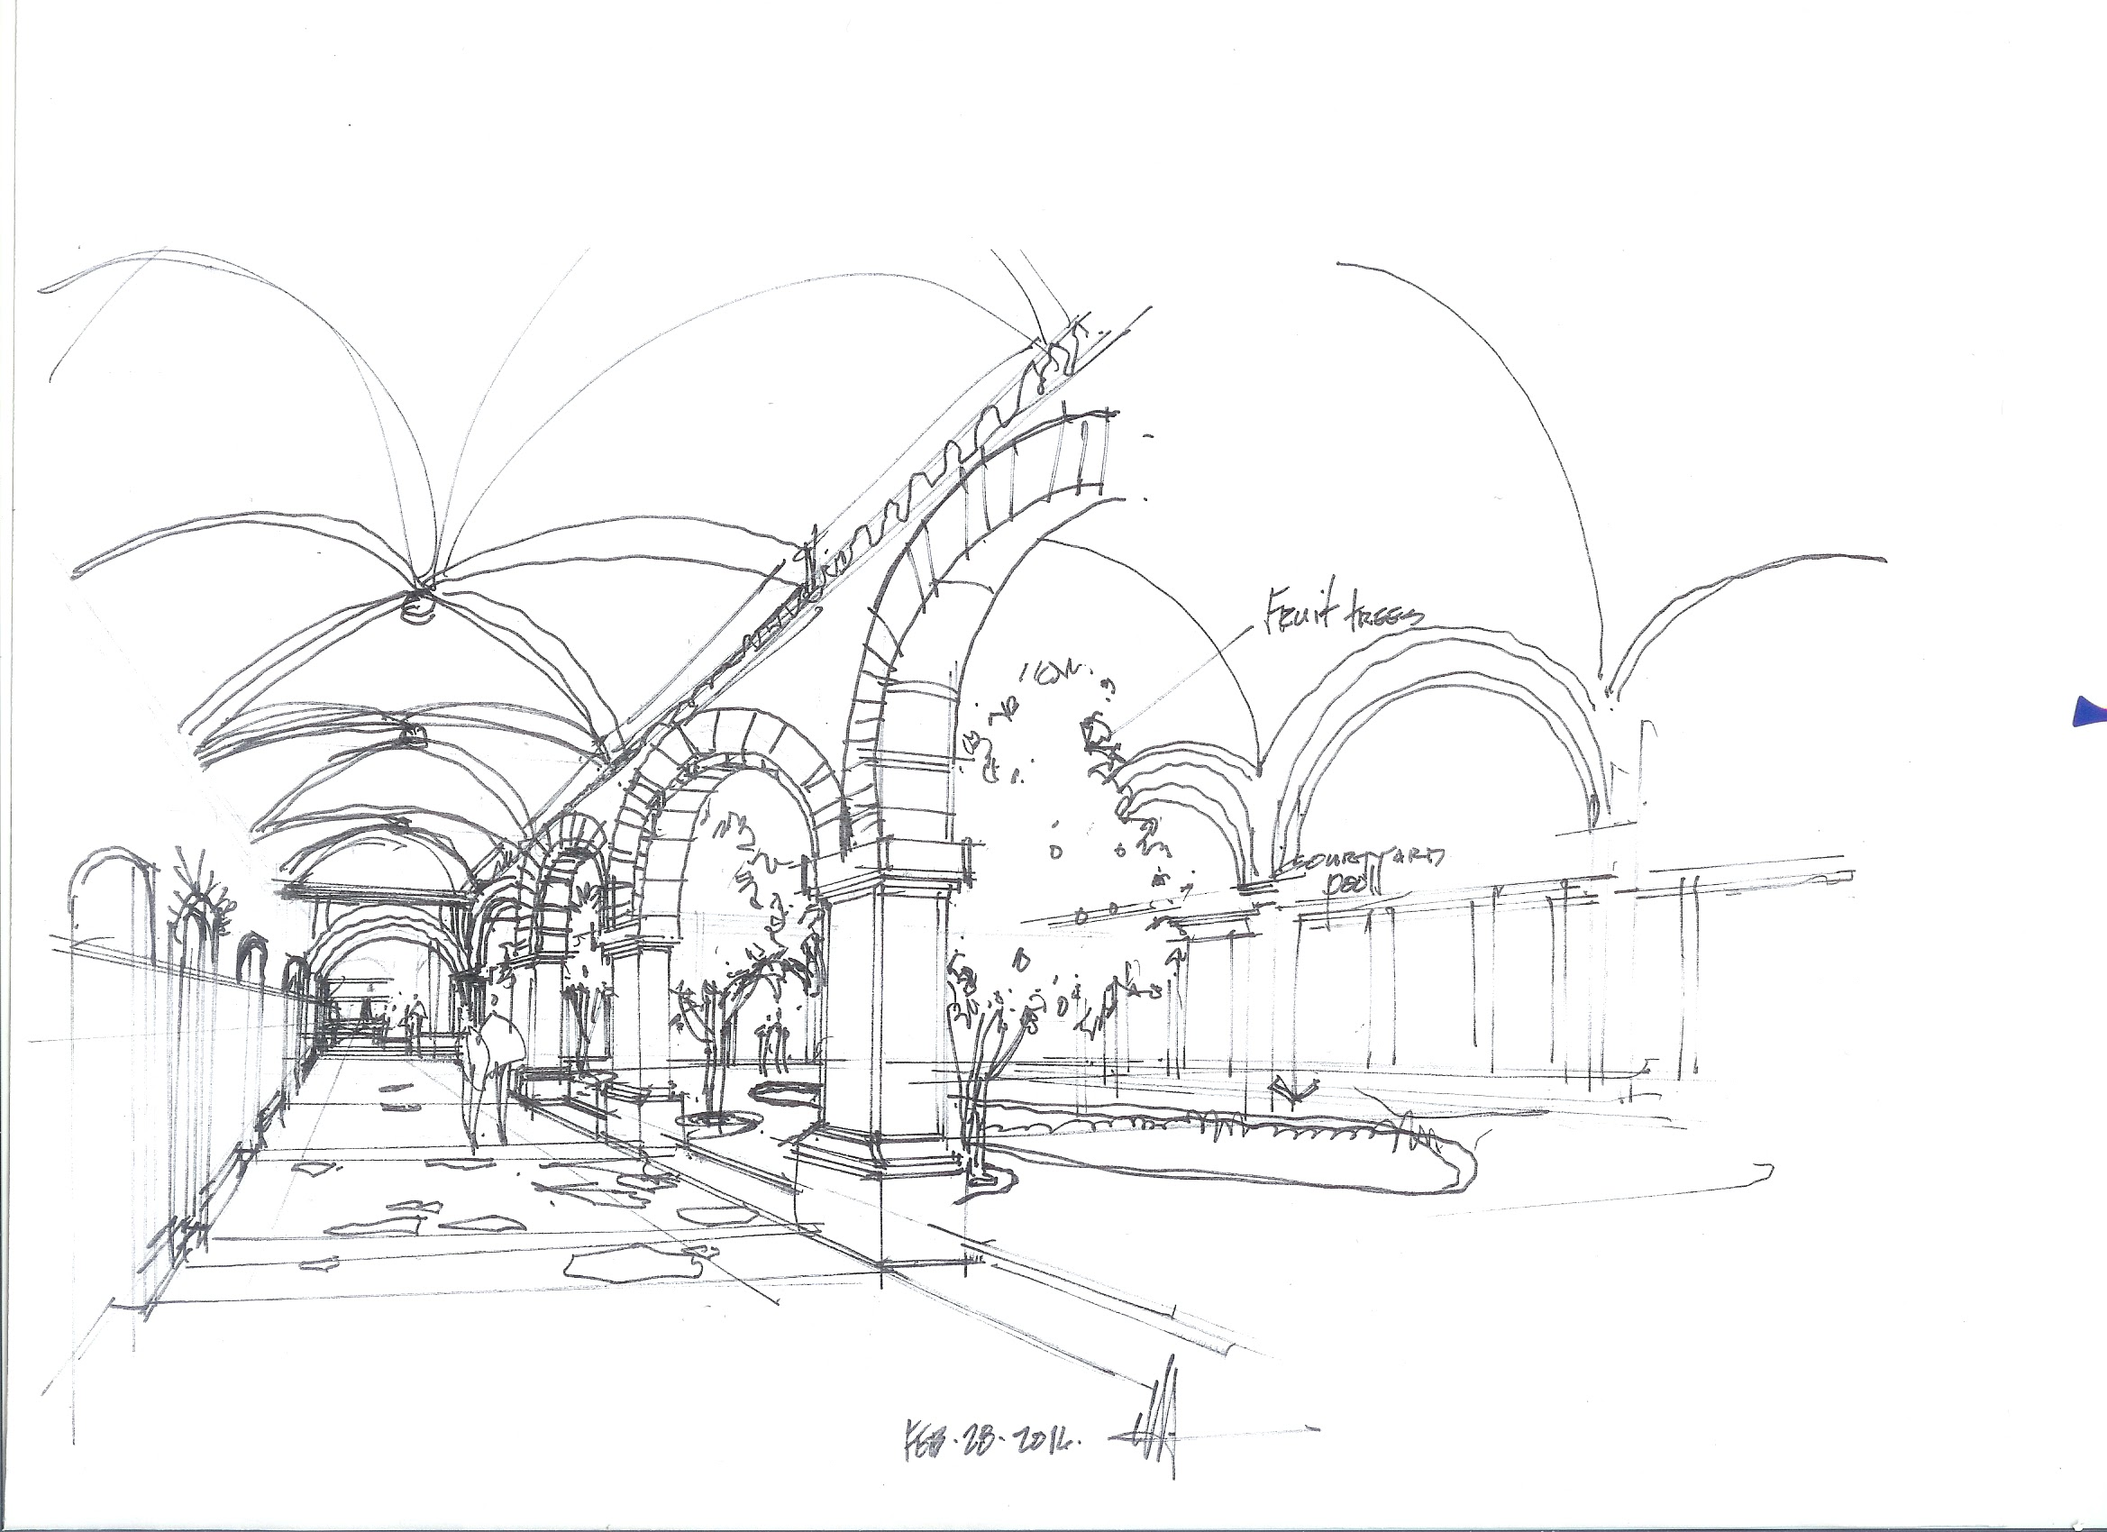
Imagine…
…building sustainable beautiful homes and gathering places with bricks made from the dirt and clay onsite - low cost and debt free
Notes:
‹#›

Slide 6
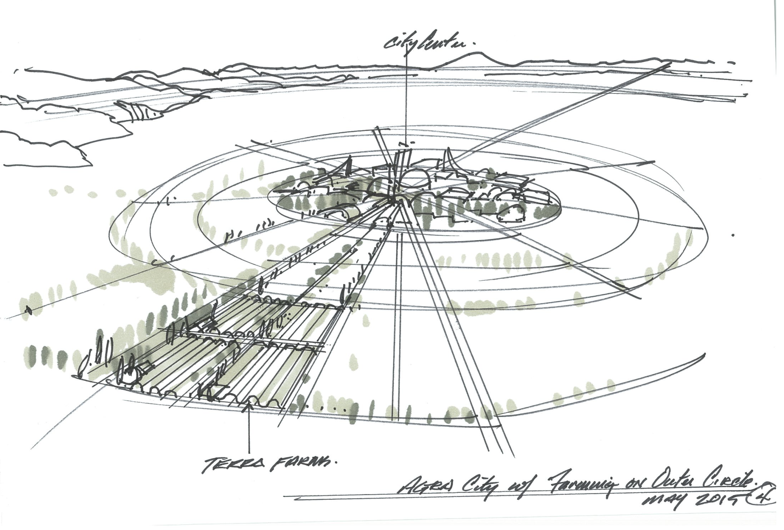
Imagine…
…a new conscious and fully sustainable way of living
Notes:
‹#›

Slide 7
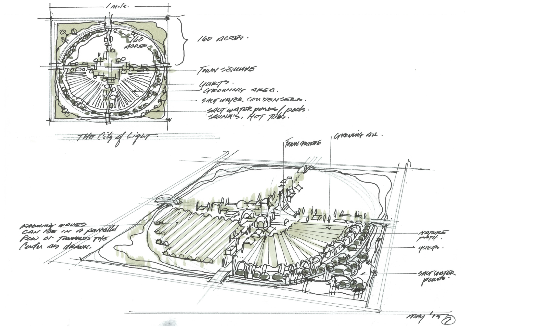
Imagine…
…an agriculture cooperative community where everyone enjoys little to no debt and minimal need for corporate and government support.
Notes:
‹#›

Slide 8
Utilizing the naturally occurring elements of Mother Earth -- dirt, wind, sun, water -- combining them in a unique integration to create micro-climate environments that are fully self-sustaining.
It is a more highly organized than other eco-systems such as permaculture because these environments house people in a beautiful and long-lasting agri-city.

Slide 9
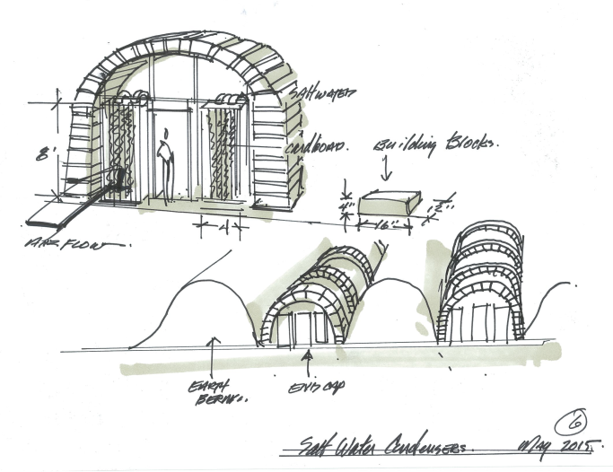
Terraculture Project
Incorporates what is abundant and local into a living system designed to support and sustain the web of life of which humans are a part.

